Slide 1
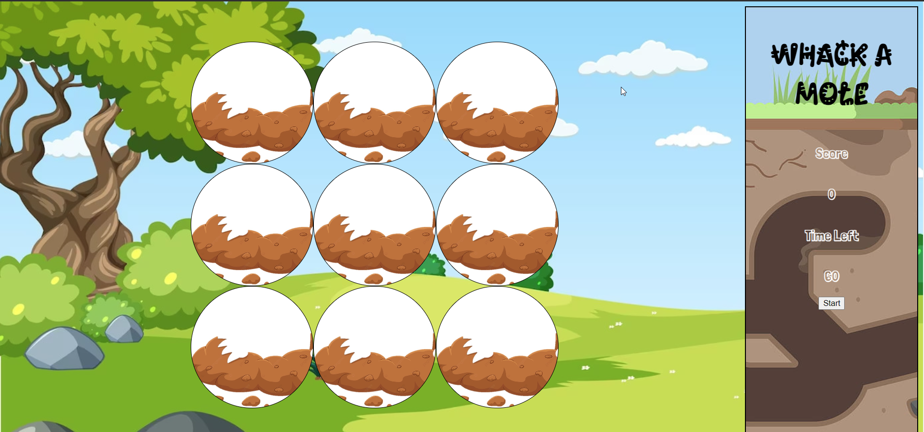

Slide 2
Create HTML/CSS/JS on VS Code
HTML : Create Divs ( Container,Scoreboard,Grid,Squares)Headers(Heading1&2,Score,Timer)Start Buttons.
CSS : Based on HTML,Create IDs in CSS on H1,H2,Container,Scoreboard,Grid,Squares,Moles.
H1 : Change Heading Fonts via font-size,font-family,and alignment
Body : Input Background-Image ,Background-size
H2:Change Heading Fonts Via Font-family and color
Scoreboard: Input Font-Family,Font-Size,color,margin,padding,text-align,width/height.Add in Flexbox via display:flex,Align the items via justify-content,align-items,border-color

Slide 3
Create HTML/CSS/JS on VS Code
HTML : Create Divs ( Container,Scoreboard,Grid,Squares)Headers(Heading1&2,Score,Timer)Start Buttons.
CSS : Based on HTML,Create IDs in CSS on H1,H2,Container,Scoreboard,Grid,Squares,Moles.
H1 : Change Heading Fonts via font-size,font-family,and alignment
Body : Input Background-Image ,Background-size
H2:Change Heading Fonts Via Font-family and color
Scoreboard: Input Font-Family,Font-Size,color,margin,padding,text-align,width/height.Add in Flexbox via display:flex,Align the items via justify-content,align-items,border-color

